Slide 1
Elements of Fair Use
How is fair use judged?

Slide 2
1. Purpose of Use
Is the work for profit or for non-profit?
Is the work educational?
Is the use for criticism or comment?
Has the material you have taken from the original work been transformed by adding new expression or meaning?
Was value added to the original by creating new information, new aesthetics, new insights, and understandings?

Slide 3
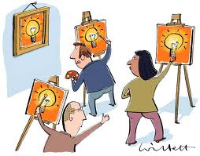
2. Nature of Use
What kind of work are you using?
Is it fact or fiction?
How old is it?
Is it published or unpublished?

Slide 4
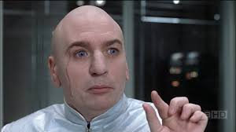
3. Amount of Use
How much have you borrowed?
Is it the “heart of the work”?

Slide 5
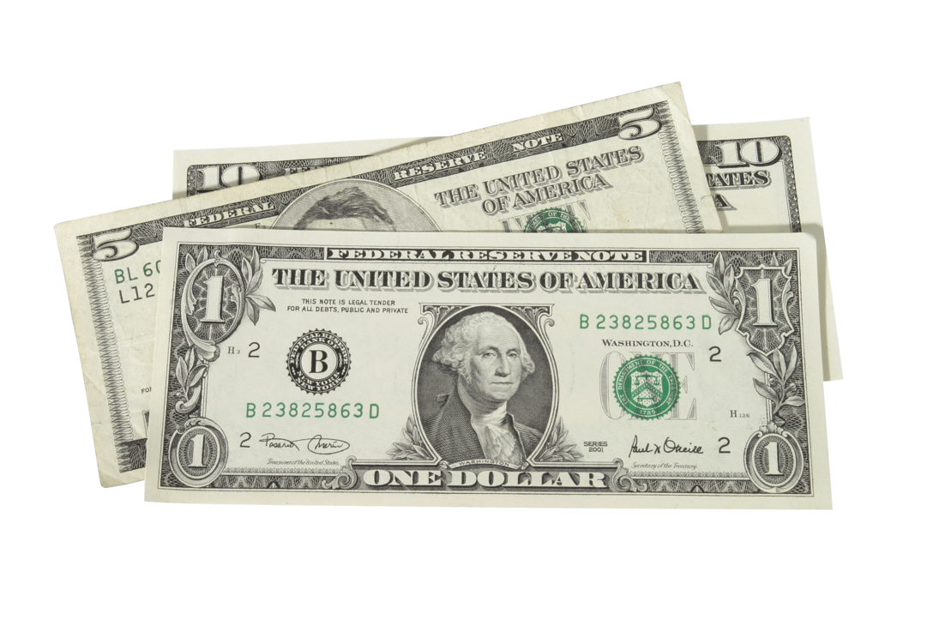
4. Effects of Use
Will your use have a significant effect on the market or potential market for the copied work?

